Slide 1
CSC 3210 Computer Organization and Programming
Lab Work 4
Dr. Zulkar Nine
mnine@gsu.edu
Georgia State University
Summer 2021

Slide 2
Learning Objective
Assembly Language Template
Assembler Directives
Writing and Debugging a program
Watch registers and flag values

Slide 3
Lab Work 4 Instructions
Lab 4: Write and run a program that can evaluate an expression (8 points)
More details on Slide – 44 and 45
Due Date: check on iCollege

Slide 4
Disclaimer
The process shown in these slides might not work in every single computer due to Operating system version, Microsoft Visual Studio versions and everything.
If you find any unusual error, you can inform the instructor.
Instructor will help you resolve the issue.

Slide 5
Attendance!

Slide 6
A review on assembly language Program Template
in Microsoft Visual Studio

Slide 7
Program Template
Program title, optional
32-bit program directives
Data section, not always needed
Code section, always needed

Slide 8
Assembler Directives
; AddTwo.asm – adds two 32-bit integers
.386
.model flat,stdcall
.stack 4096
ExitProcess PROTO, dwExitCode:DWORD
.code
main PROC
mov eax,5 ; move 5 to the EAX register
add eax,6 ; add 6 to the EAX register
INVOKE ExitProcess,0
main ENDP
END main
.386 directive, identifies this as a 32-bit program that can access 32-bit registers and addresses.
.model selects the program’s memory model (flat), and identifies the calling convention (named stdcall) for procedures. Ex. Windows API
.stack aside 4096 bytes of storage for the runtime stack, which every program must have. Size of a memory page.

Slide 9
Assembler Directives
; AddTwo.asm – adds two 32-bit integers
.386
.model flat,stdcall
.stack 4096
ExitProcess PROTO, dwExitCode:DWORD
.code
main PROC
mov eax,5 ; move 5 to the EAX register
add eax,6 ; add 6 to the EAX register
INVOKE ExitProcess,0
main ENDP
END main
ExitProcess, declares a prototype for the ExitProcess function.
- A prototype consists of the function name, the PROTO keyword, a comma, and a list of input parameters.
- The input parameter for ExitProcess is named dwExitCode.
.CODE directive marks the beginning of the code area of a program, the area that contains executable instructions
The label main identifies the program entry point (main) and marks the address at which the program will begin to execute.

Slide 10
Assembler Directives
; AddTwo.asm – adds two 32-bit integers
.386
.model flat,stdcall
.stack 4096
ExitProcess PROTO, dwExitCode:DWORD
.code
main PROC
mov eax,5 ; move 5 to the EAX register
add eax,6 ; add 6 to the EAX register
INVOKE ExitProcess,0
main ENDP
END main
INVOKE Calls on, the procedure ExitProcess, passing the arguments on the stack or in registers.
ENDP directive marks the end of a procedure. Our program had a procedure named main,
end directive marks the last line to be assembled, and it identifies the program entry point (main).

Slide 11
Writing and Debugging
A program

Slide 12
Writing & Debugging a Program
Exercise 1: Write and run a program to solve the following problem:
EAX = (ECX + EBX) – EDX
Assume that all the values are 32 bit and all the registers are 32 bit as well
Store the following decimal values into the registers -
15 to ECX, 15 to EBX and 31 to EDX
Evaluate the above expression
Store the result in EAX register
To create a project for this exercise, follow the steps provided in next slides (similar to lab 2)
To verify the result in EAX, follow the steps in the slides titled : “Showing registers and flags”

Slide 13
Steps to follow
Follow the steps :
Step 1: Create a project
Step 2: Write your code to evaluate, EAX = (ECX + EBX) – EDX
Step 3: Build the project
Step 4: Debug the project

Slide 14
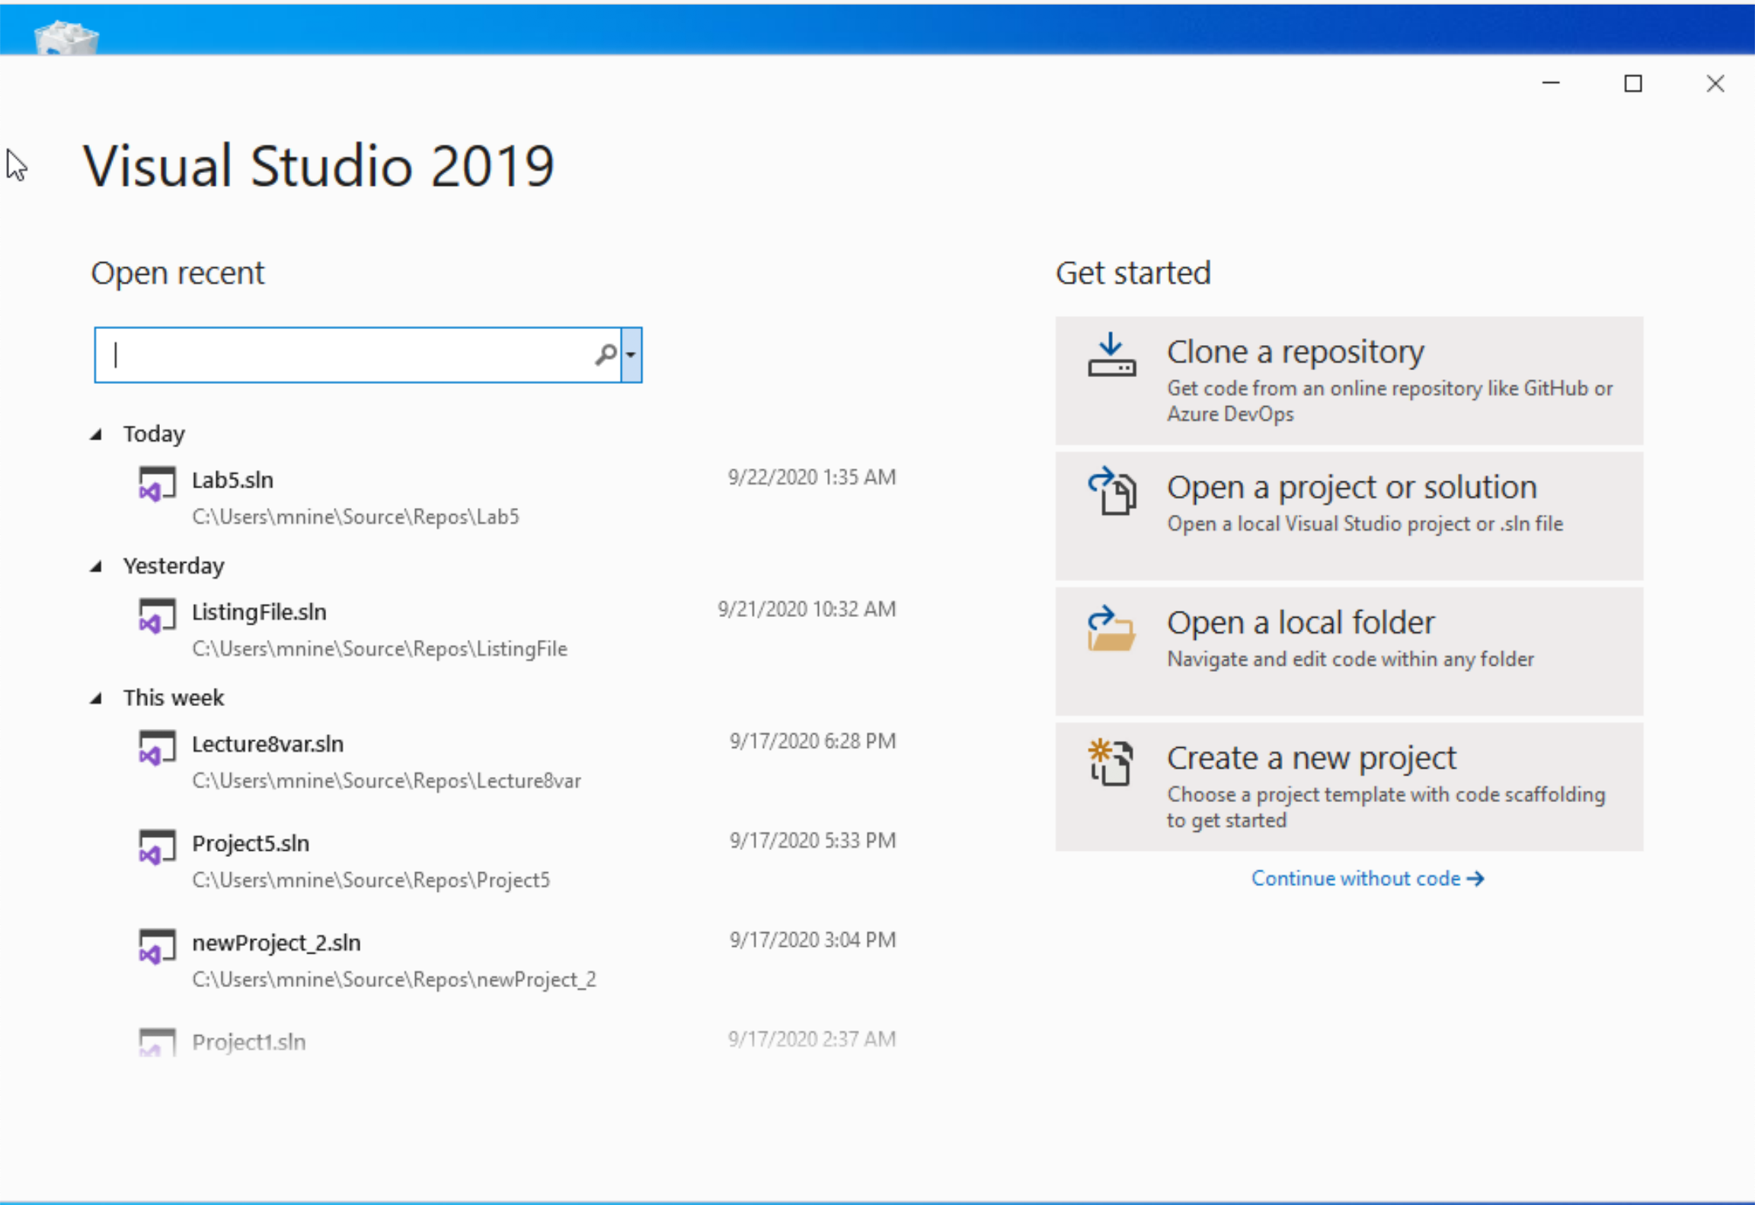


Step 1: Create a project (1)
Start Visual Studio
Click Create a new Project

Slide 15
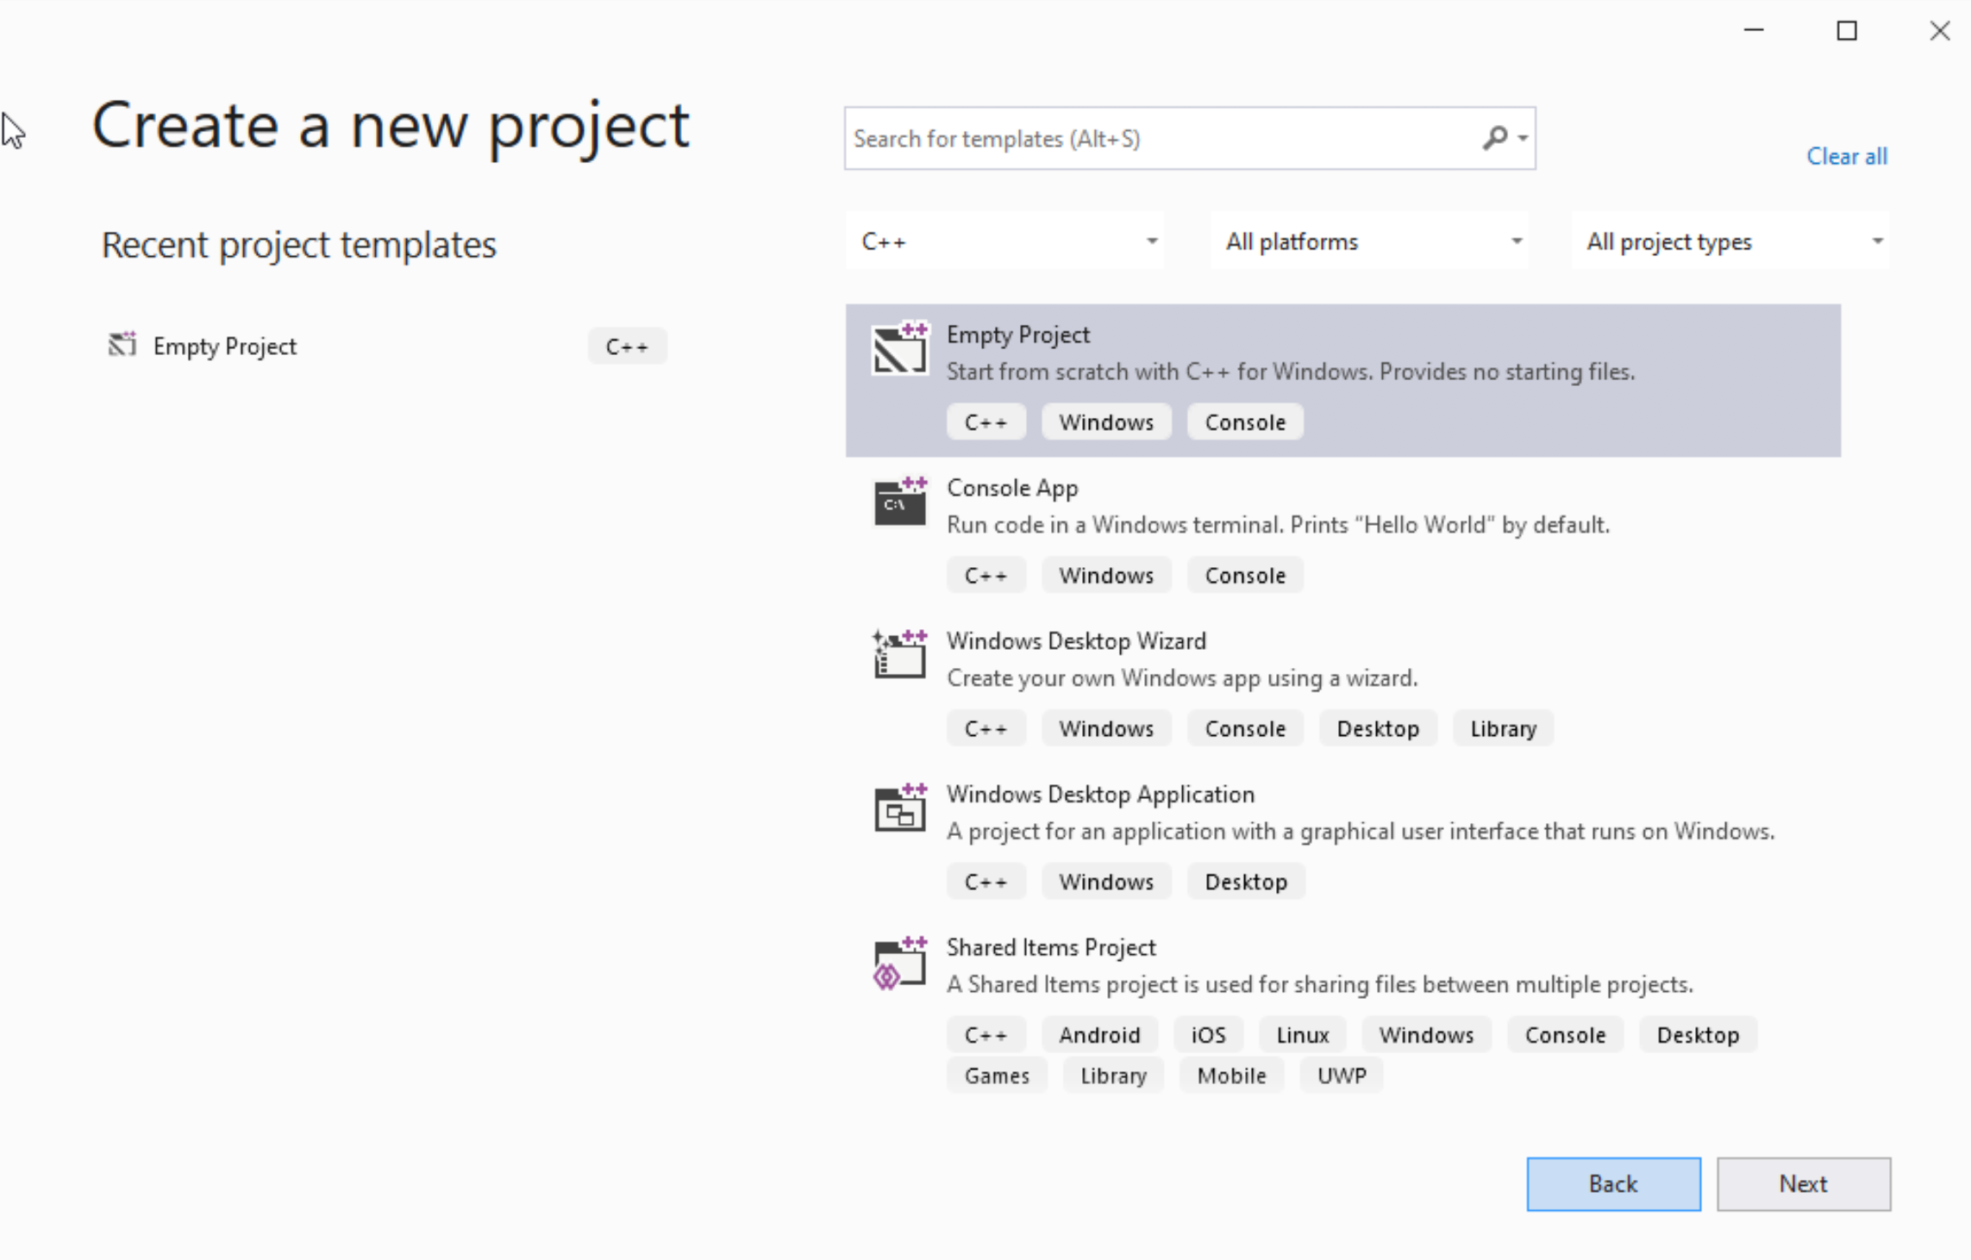




Step 1: Create a project (2)
Select C++ as language
Select Empty Project
Click Next

Slide 16
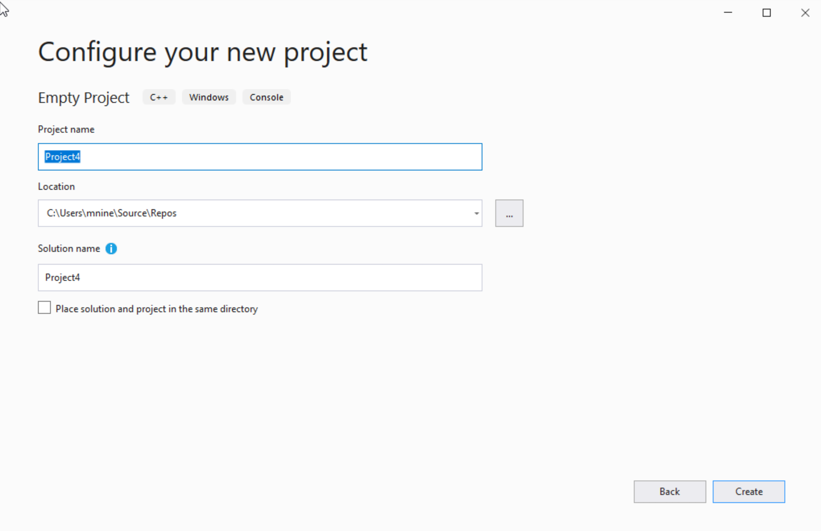

Step 1: Create a project (3)
You can change the project
name as you like
Also you can change the
project location
Click Next

Slide 17
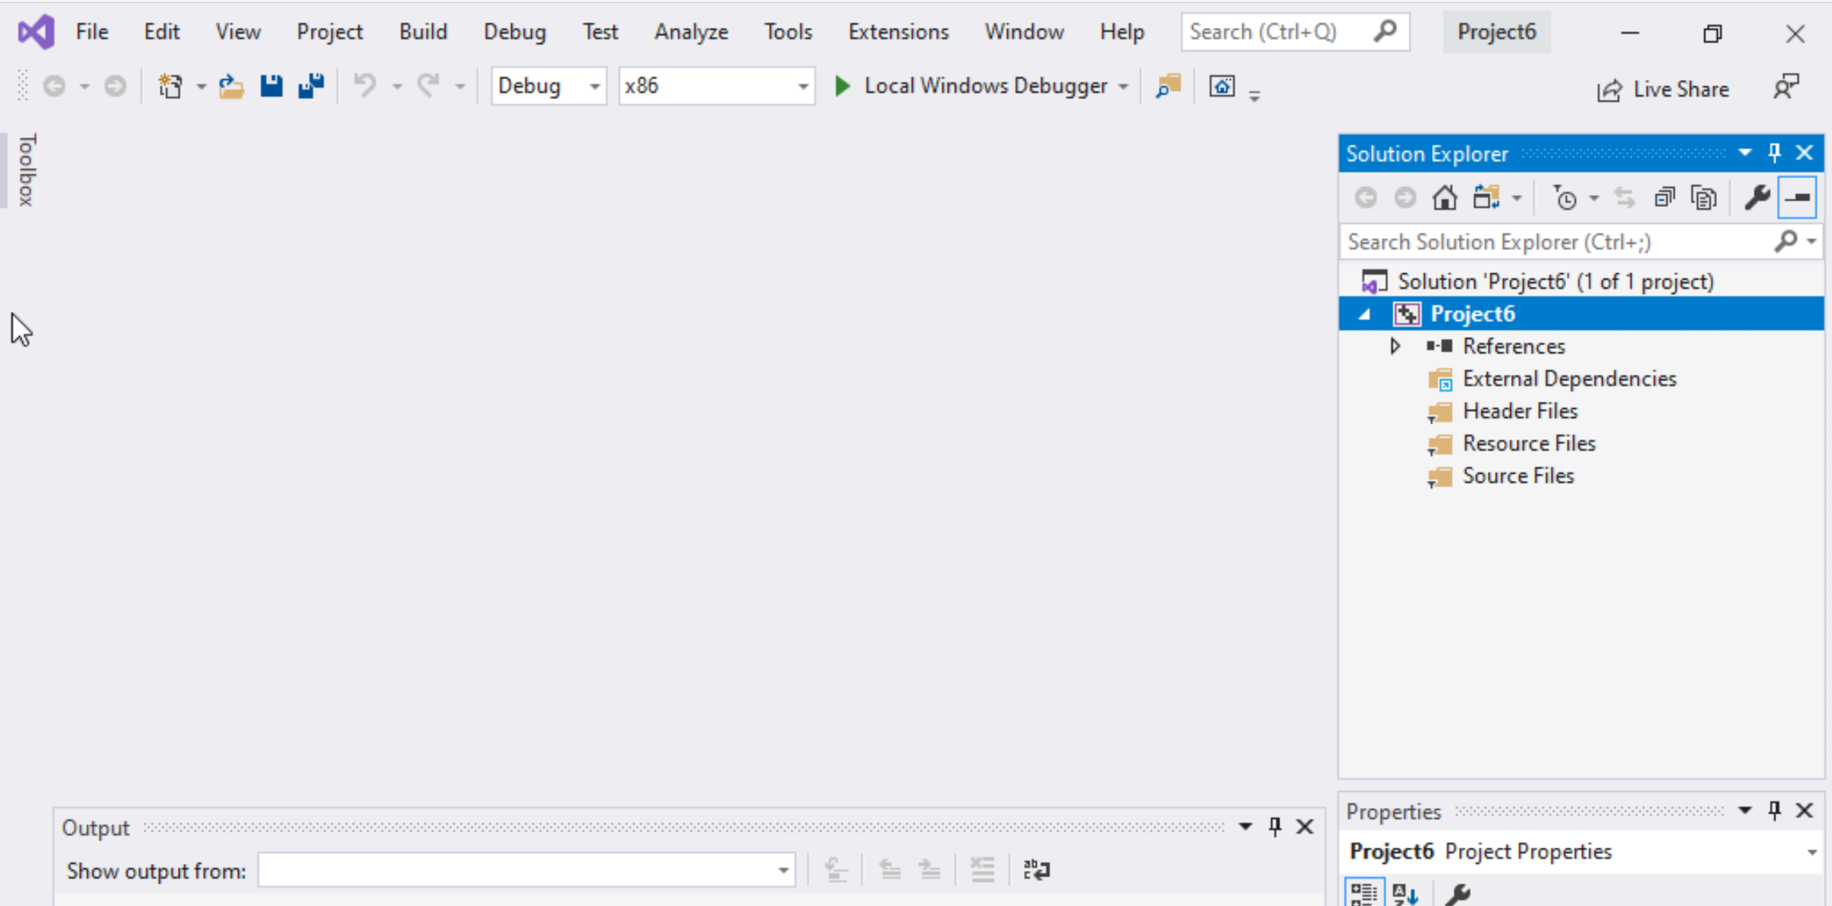
Step 1: Create a project (4)
Delete the
Following folders:
Header files
Resources Files, and
Source Files

Slide 18
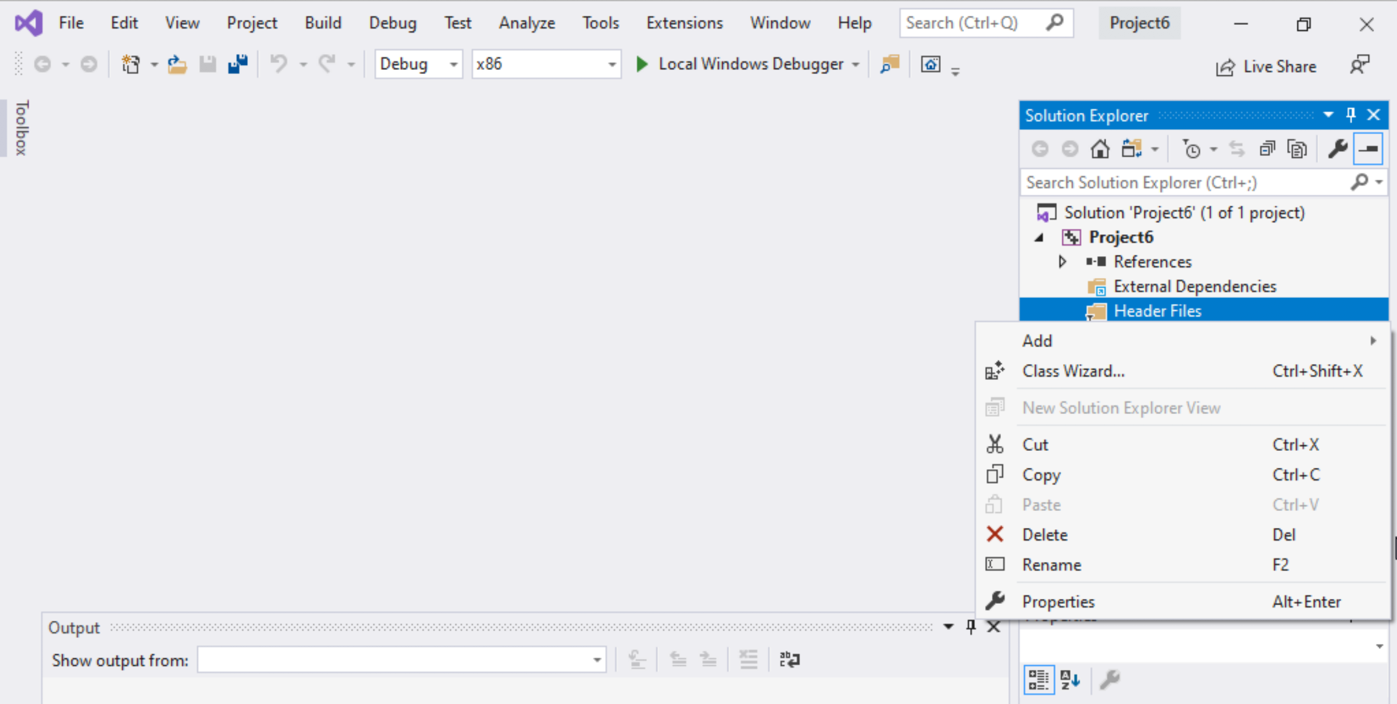
Step 1: Create a project (5)
To delete :
Select the folders
Right click on it
Select delete

Slide 19
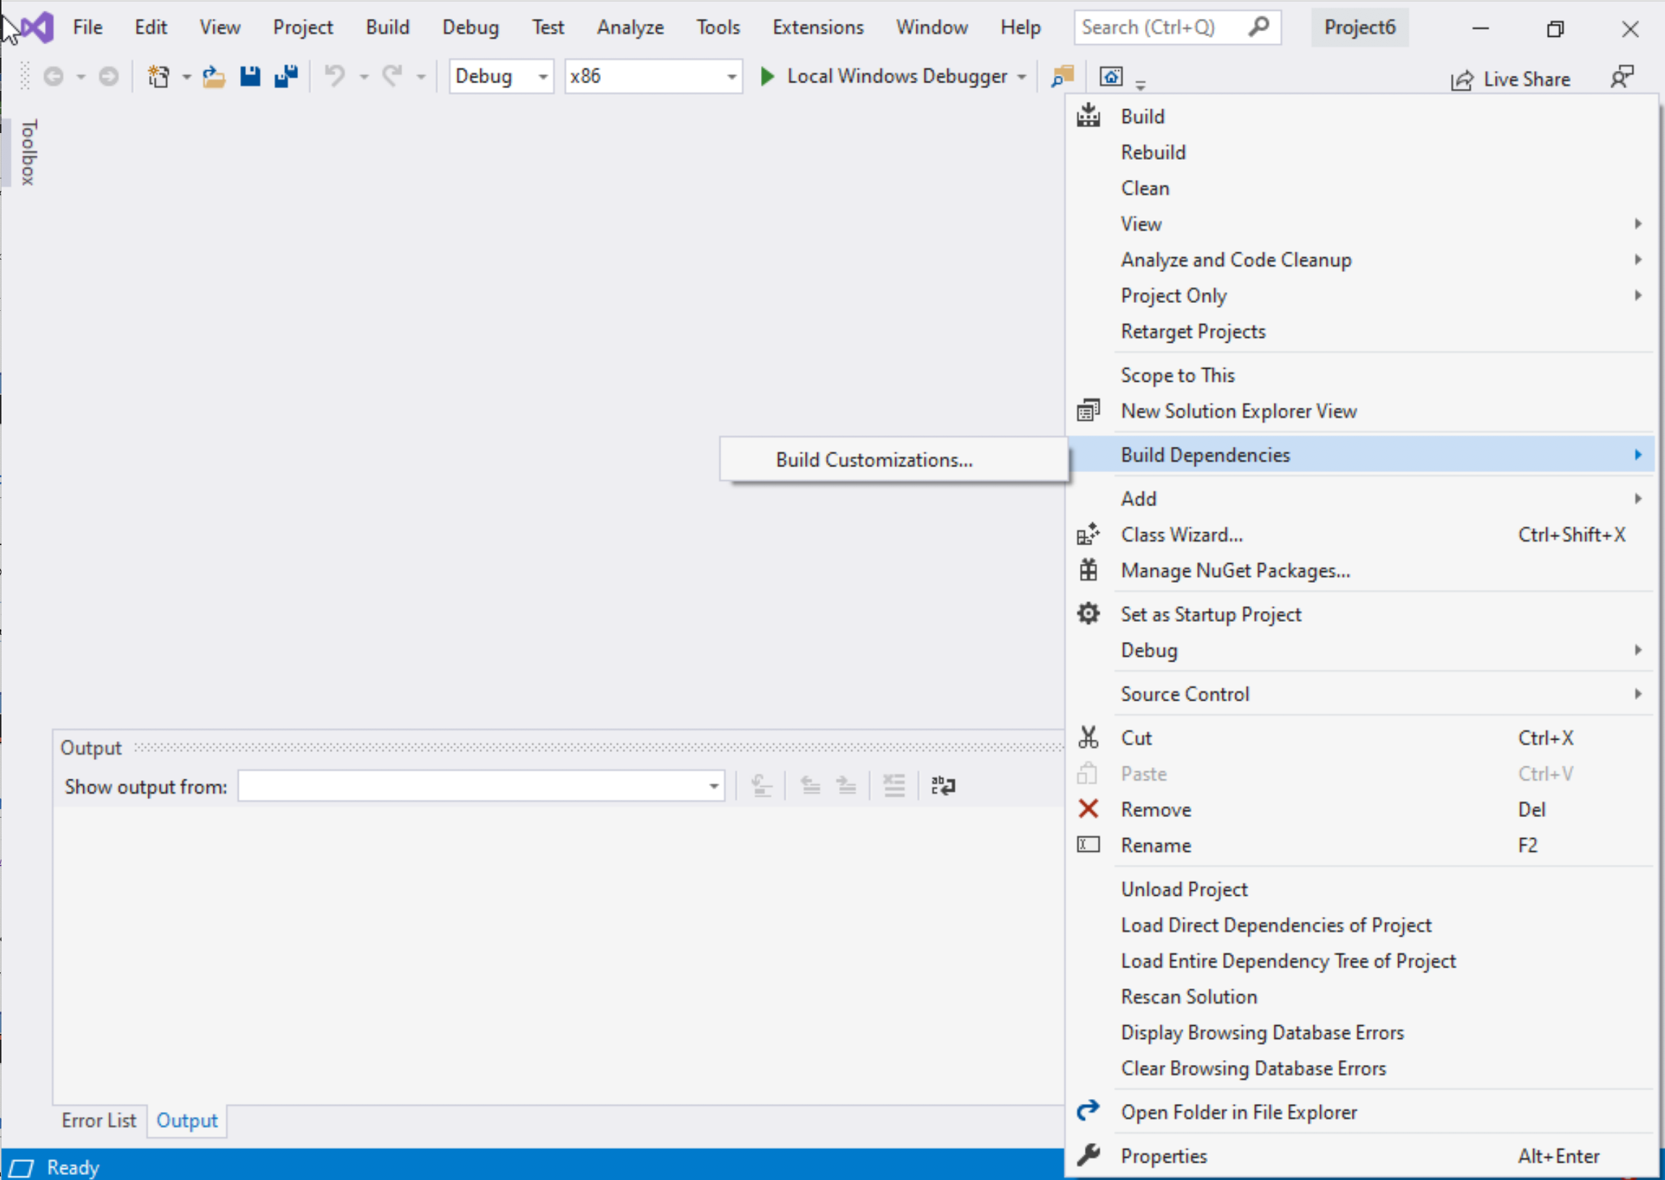
Step 1: Create a project (6)
Select Project Name on solution explorer
Right click on it
Go to Build Dependencies
Click on Build Customizations

Slide 20
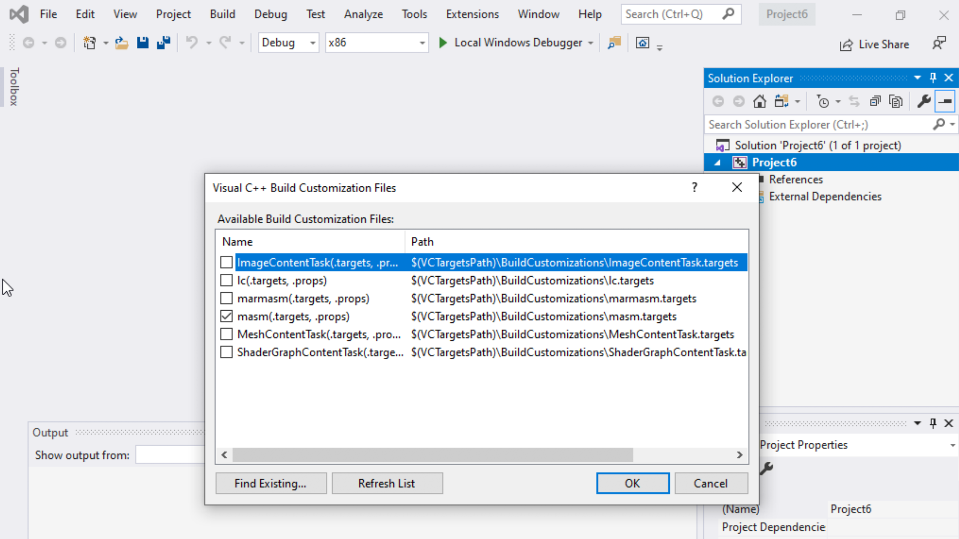
Step 1: Create a project (7)
Select mash(.target, .props)
Click ok

Slide 21
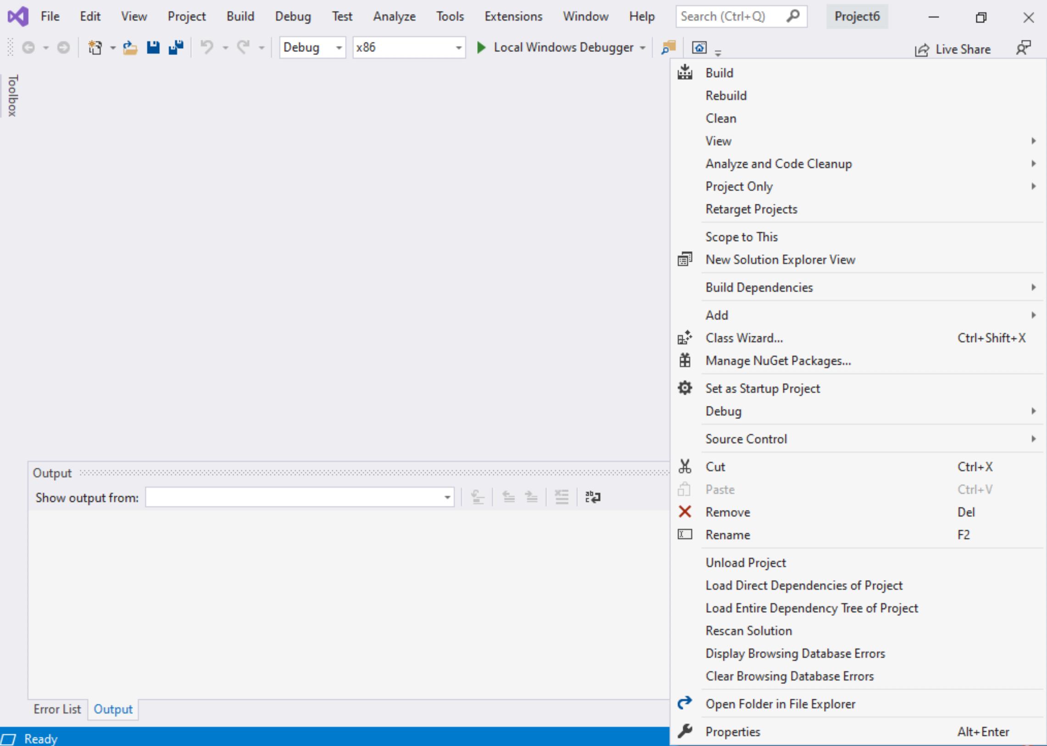
Step 1: Create a project (8)
Right click on the Project name in the solution explorer
Click properties

Slide 22
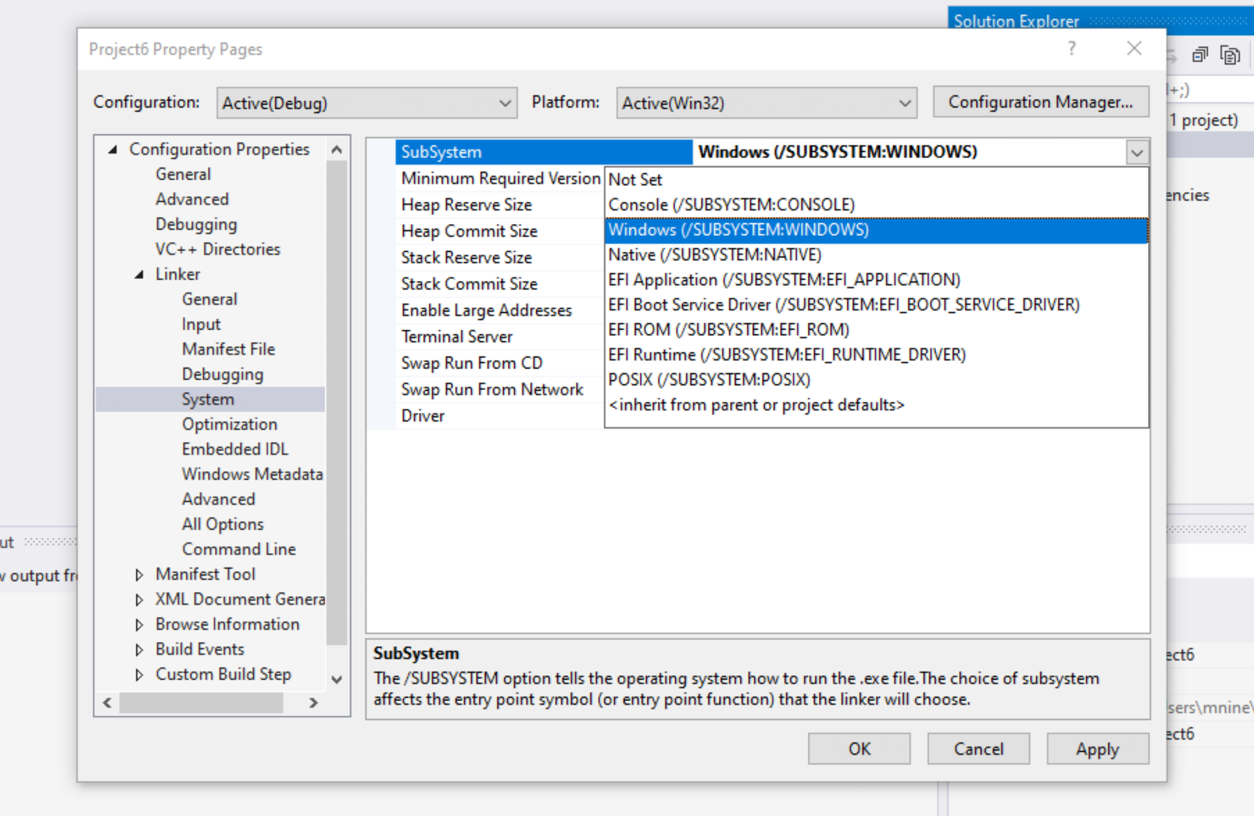

Step 1: Create a project (9)
Select Windows(/SUBSYSTEM:WINDOWS)
Click OK

Slide 23
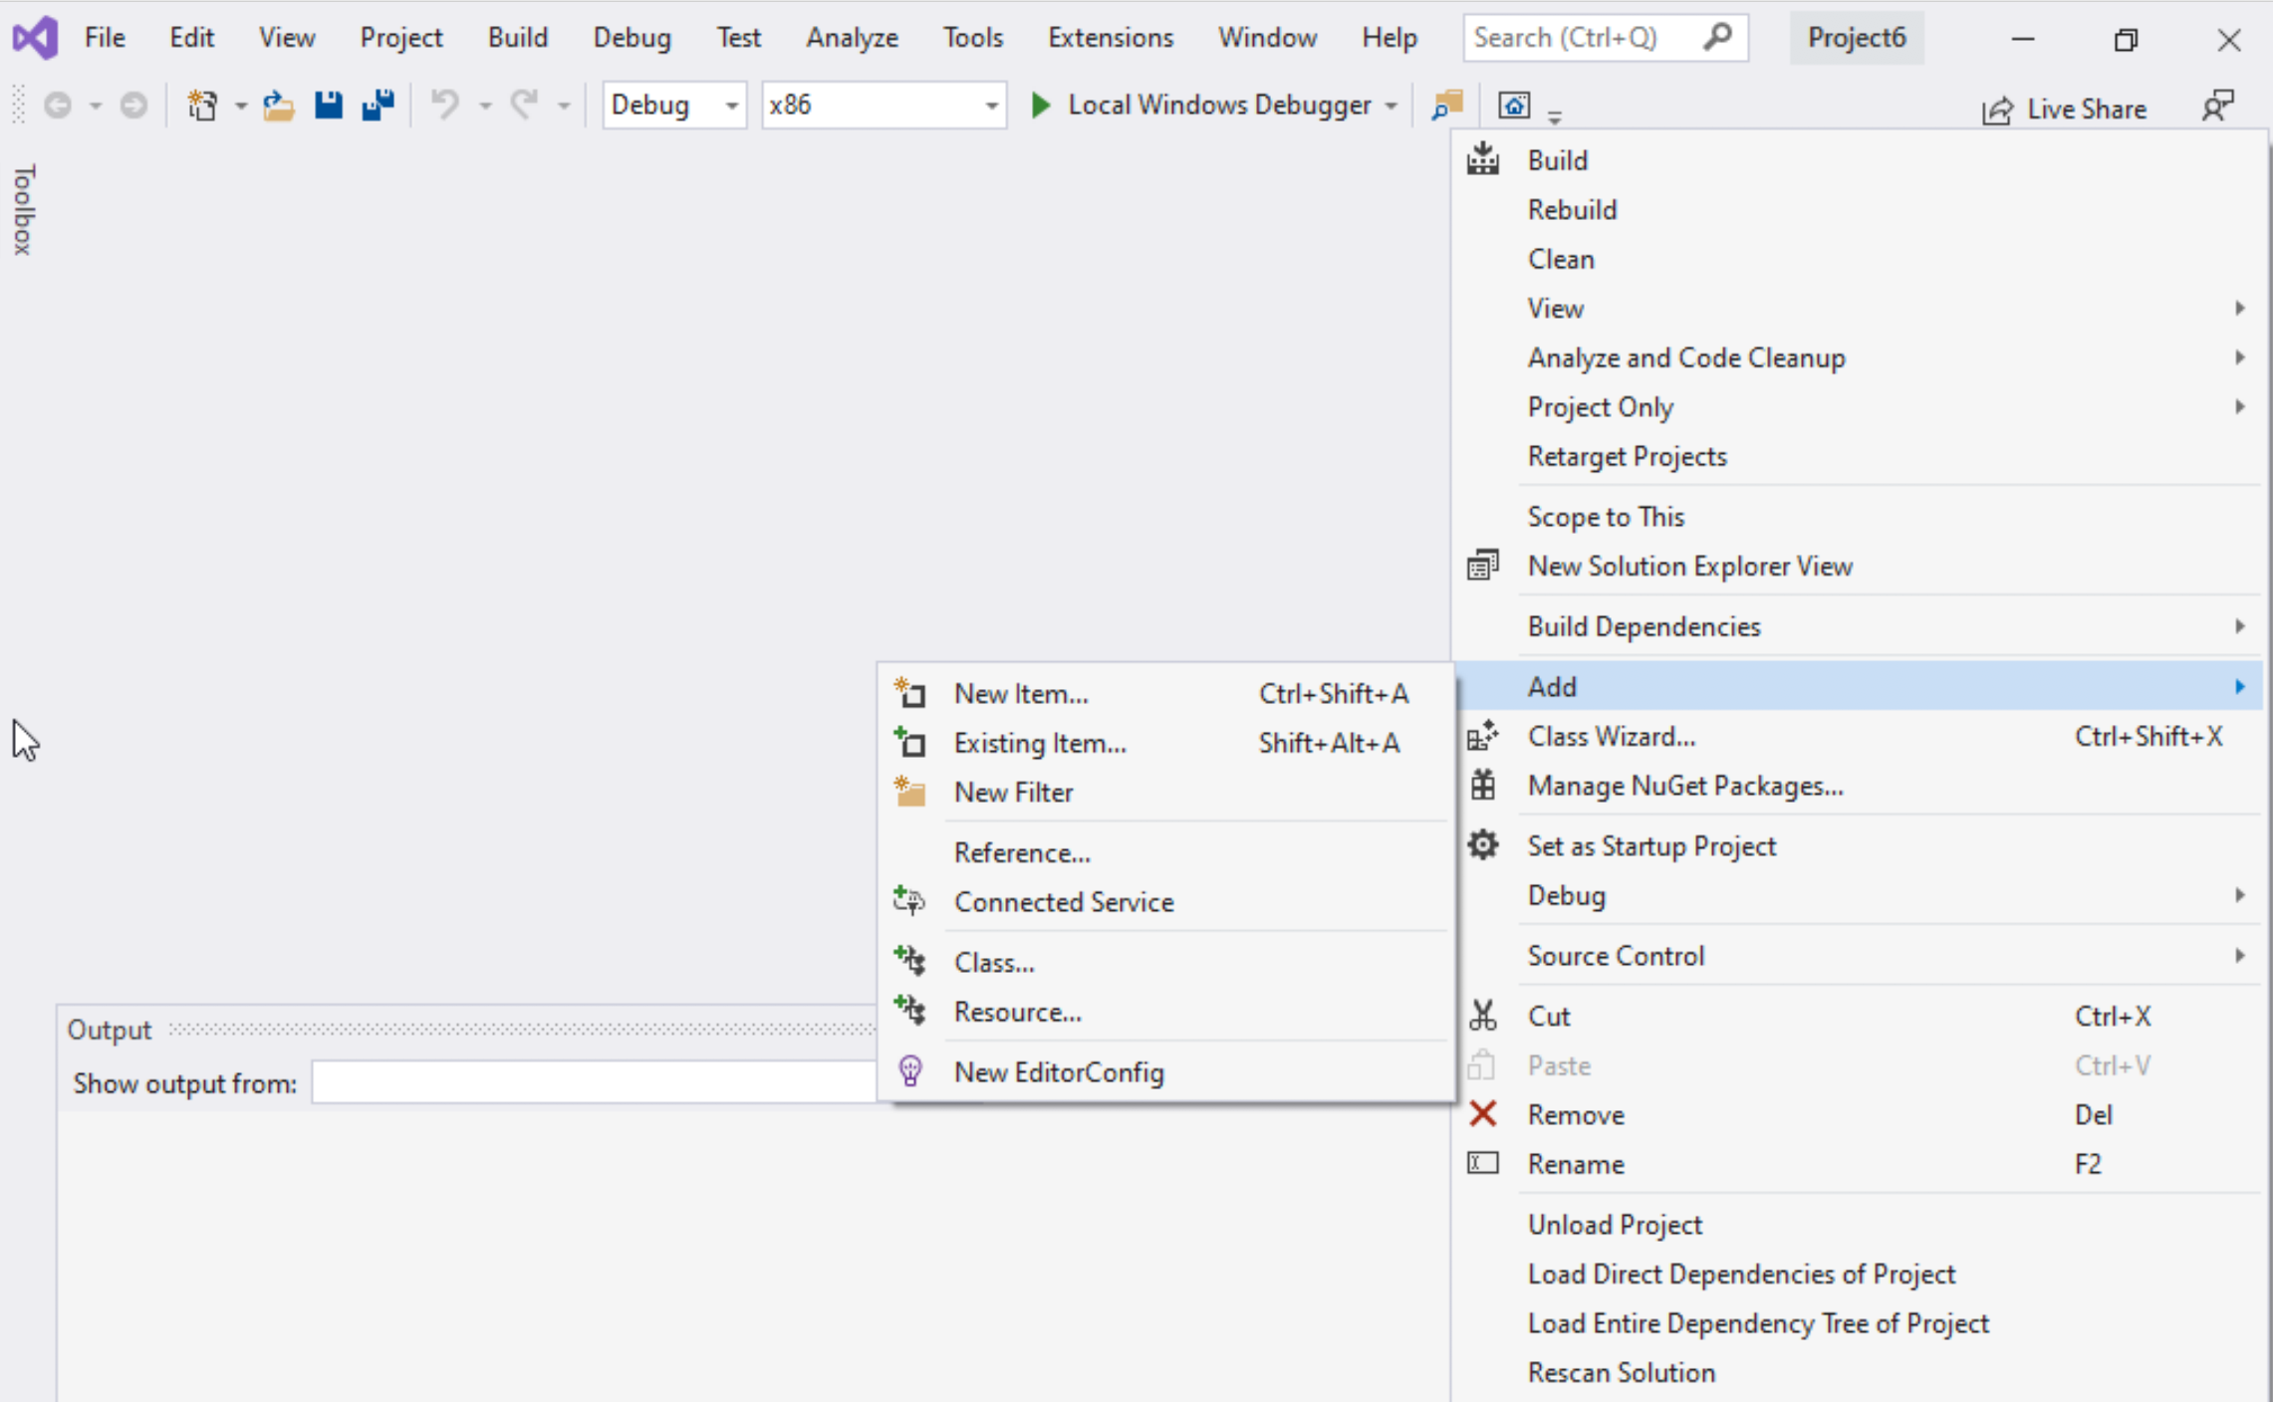
Step 1: Create a project (10)
Select Project name on solution explorer
Right click on it
Expand Add
Choose New Item

Slide 24
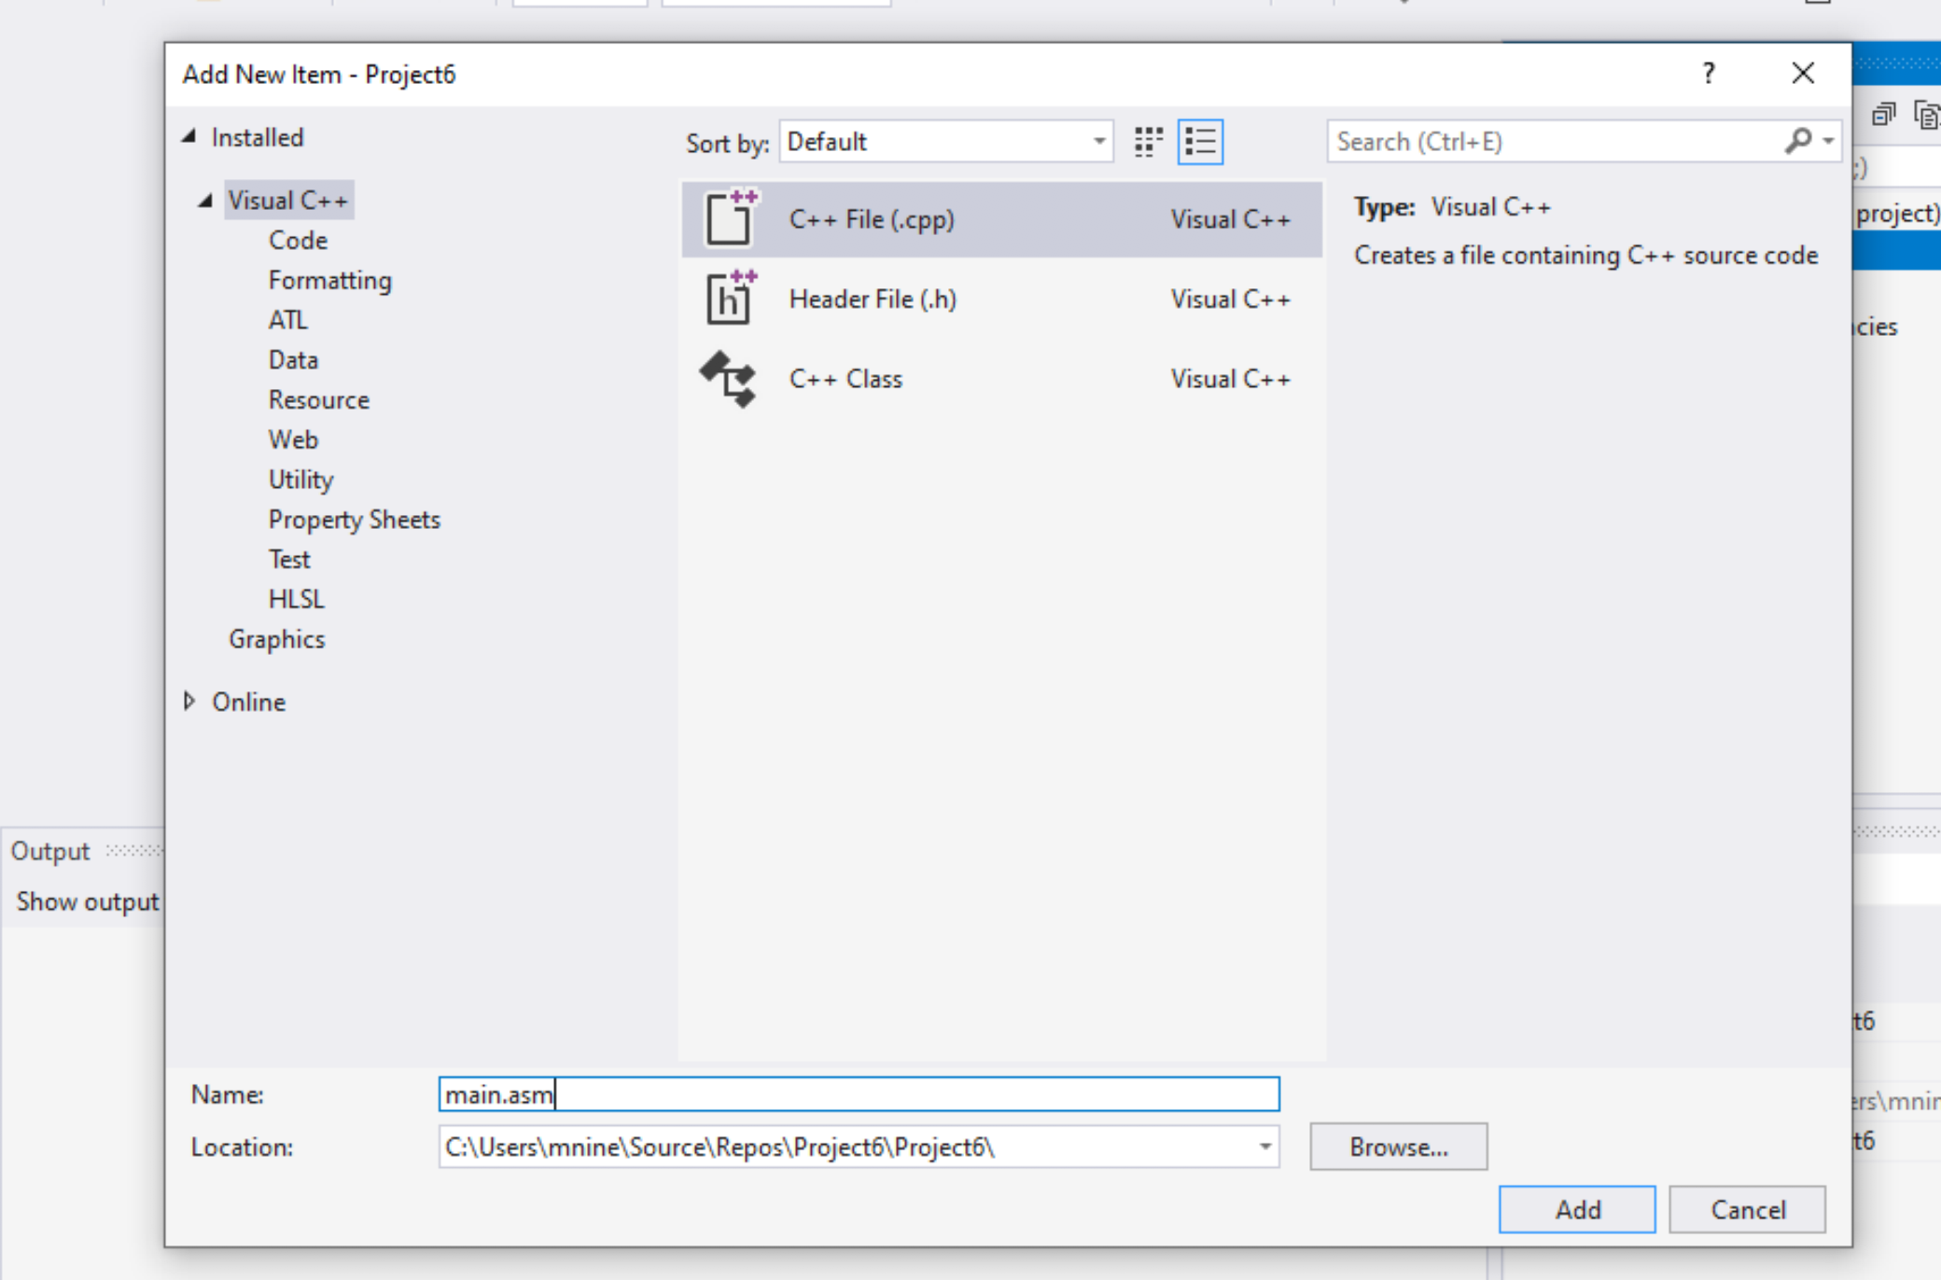


Step 1: Create a project (11)
Select C++ File(.cpp)
Name: main.asm
Click Add

Slide 25
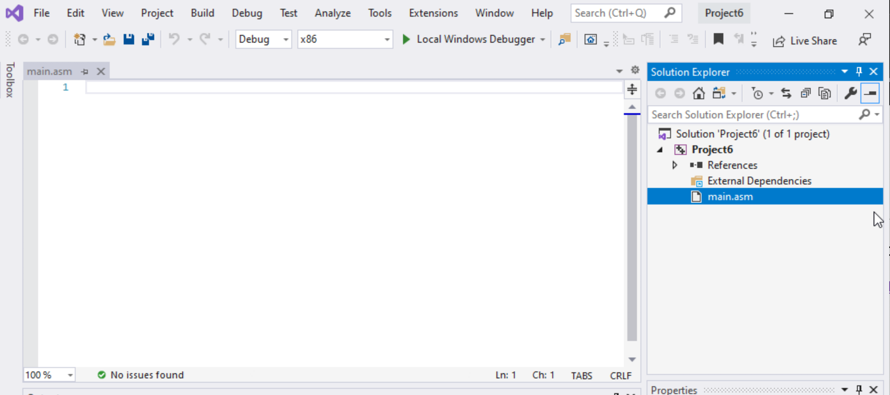

Step 1: Create a project (12)
Select main.asm
Add your code
In the main.asm File.

Slide 26
Step 2: Write your code to evaluate, EAX = (ECX + EBX) – EDX
Make the required changes:
EAX = (ECX + EBX) – EDX
Move to ECX the value 15
Move to EBX the value 15
Move to EDX the value 31
Add EBX to ECX
Subtract EDX from ECX (😳)
Move the result in ECX to EAX
Done
; AddTwo.asm - adds two 32-bit integers.
; Chapter 3 example
.386
.model flat,stdcall
.stack 4096
ExitProcess proto,dwExitCode:dword
.code
main proc
mov eax,5
add eax,6
invoke ExitProcess,0
main endp
end main
Replace this

Slide 27
Step 2: The code
; AddTwo.asm - adds two 32-bit integers.
; Chapter 3 example
.386
.model flat,stdcall
.stack 4096
ExitProcess proto,dwExitCode:dword
.code
main proc
mov ecx,15
add ebx,15
mov edx,31
add ecx,ebx
sub ecx,edx
mov eax,ecx
invoke ExitProcess,0
main endp
end main

Slide 28
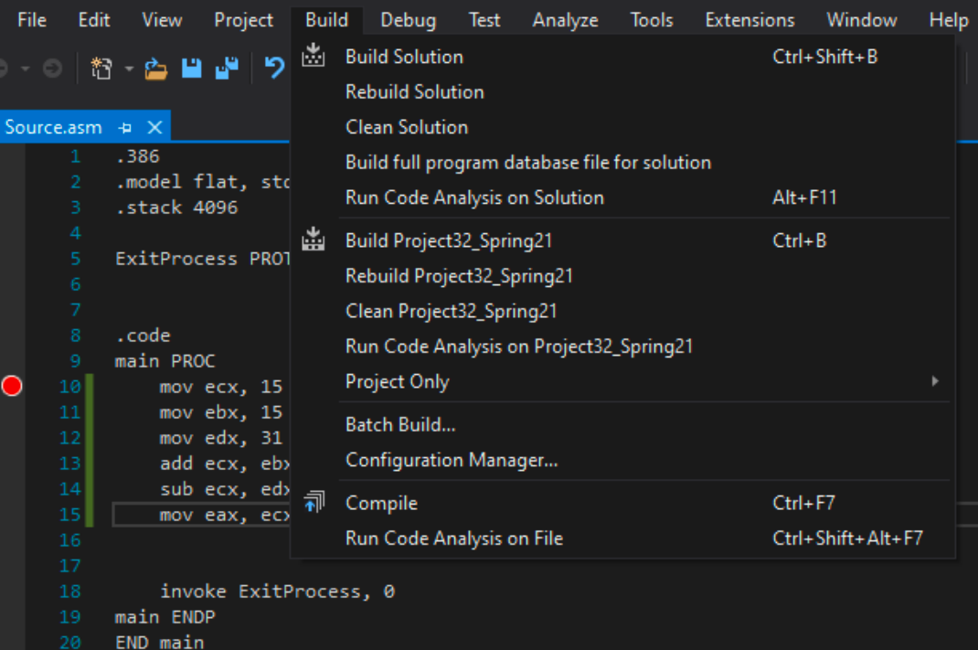
Step 3: Build the Project (1)
Select Build Project from the Build menu.
This will assemble and link your program and create an executable file.

Slide 29
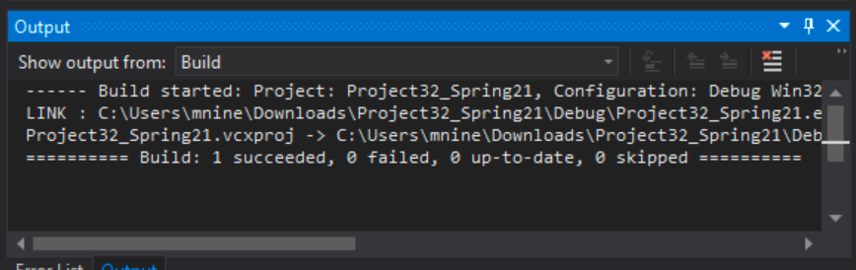
Step 3: Build the Project (2)
You should see messages like the following in your output window, indicating the build progress:
﻿You should see the message in the last line:
=====Build: 1 succeeded, 0 failed, 0 up-to-date, 0 skipped =====

Slide 30
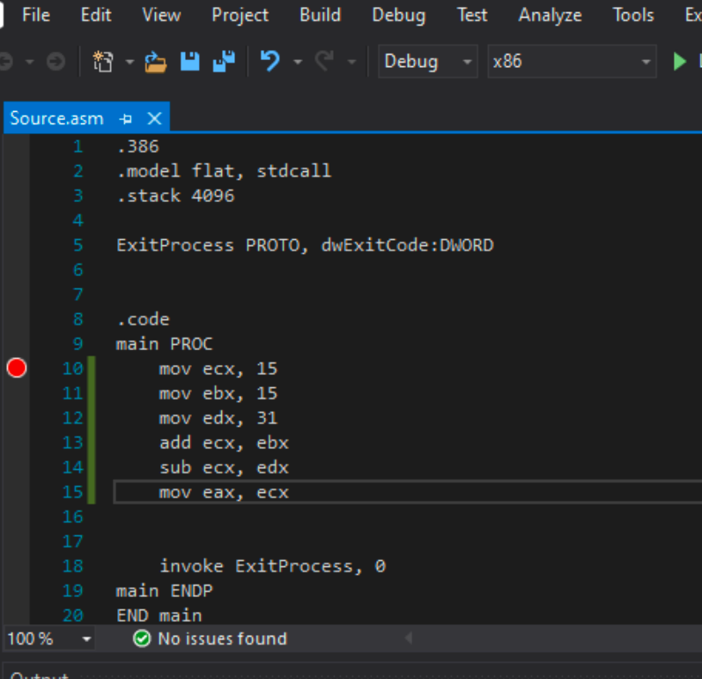

Step 4: Debug the project (1)
Set a breakpoint first.
Set a breakpoint on a program statement by clicking the mouse in the vertical gray bar just to the left of the code window.
A large red dot will mark the breakpoint location.
In this case, set a breakpoint at Line 10.

Slide 31
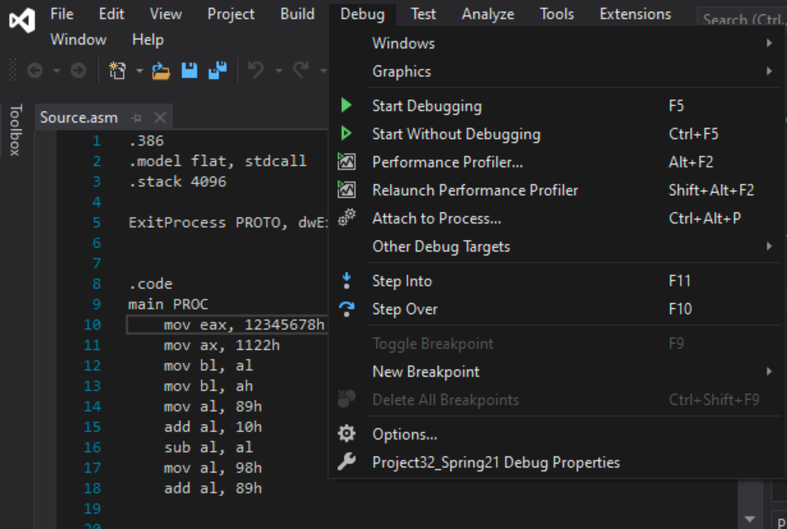
Step 4: Debug the project (2)
Run the Program by selecting Start Debugging from the Debug menu.

Slide 32
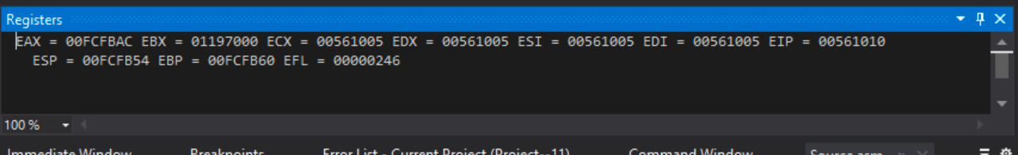
Step 4: Debug the project (3)
You should be able to see the register window :

Slide 33
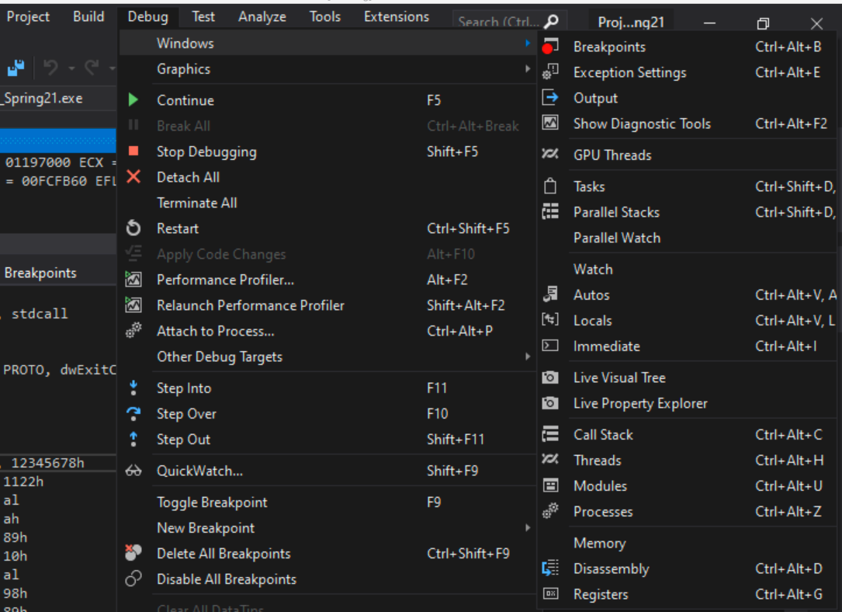

Step 4: Debug the project (4)
If you don’t see the register window: Go to : Debug ->Windows->registers.

Slide 34
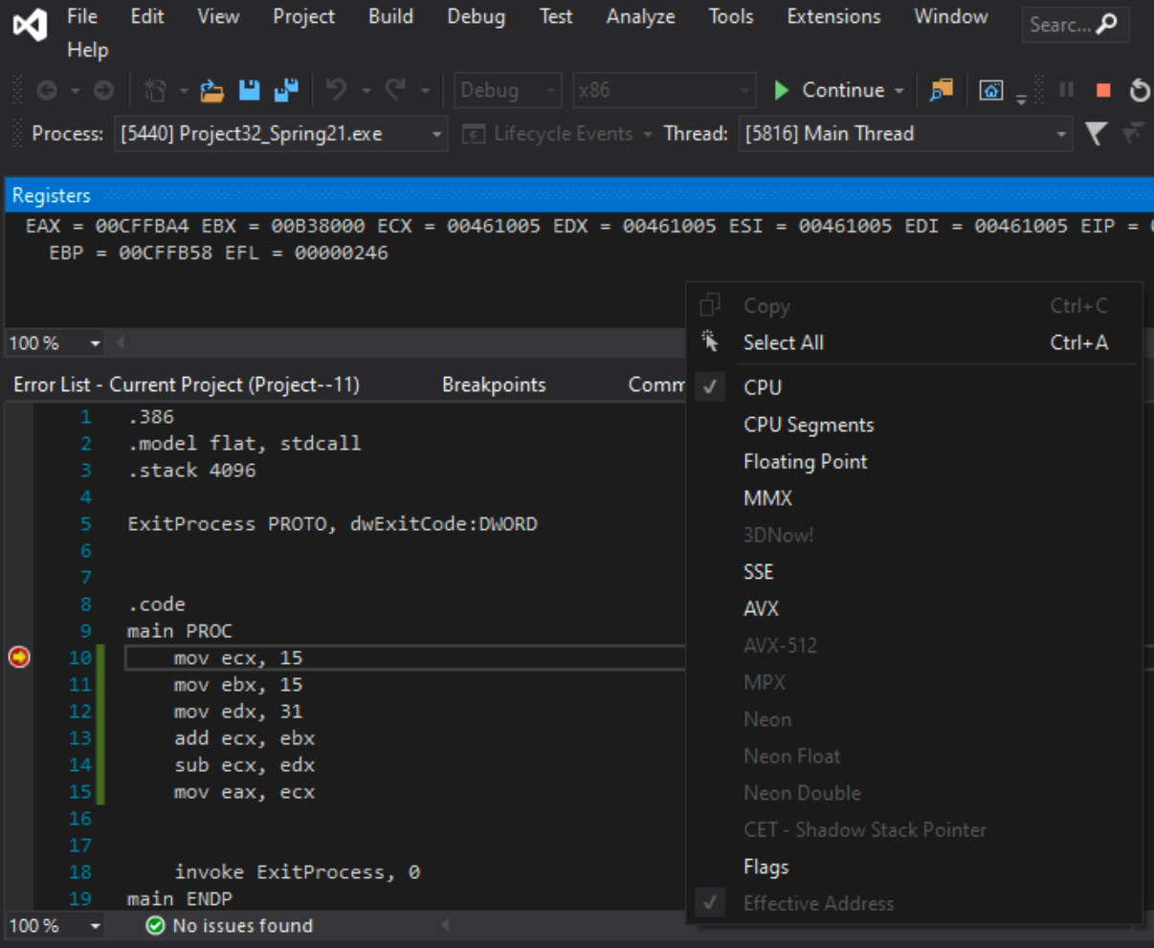
Step 4: Debug the project (5)
Right click on the register window
Turn on the EFLAGS in the
register window.

Slide 35
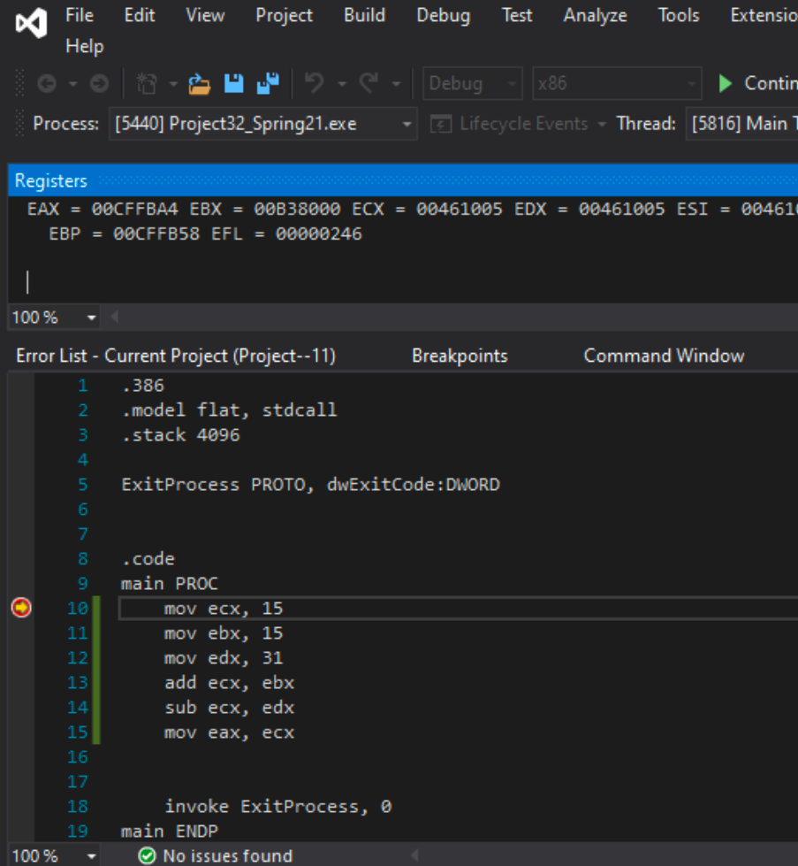

Step 4: Debug the project (6)
Now the red dot (breakpoint) has a yellow pointer inside of it now.
That means code execution halts at line 10 now.

Slide 36
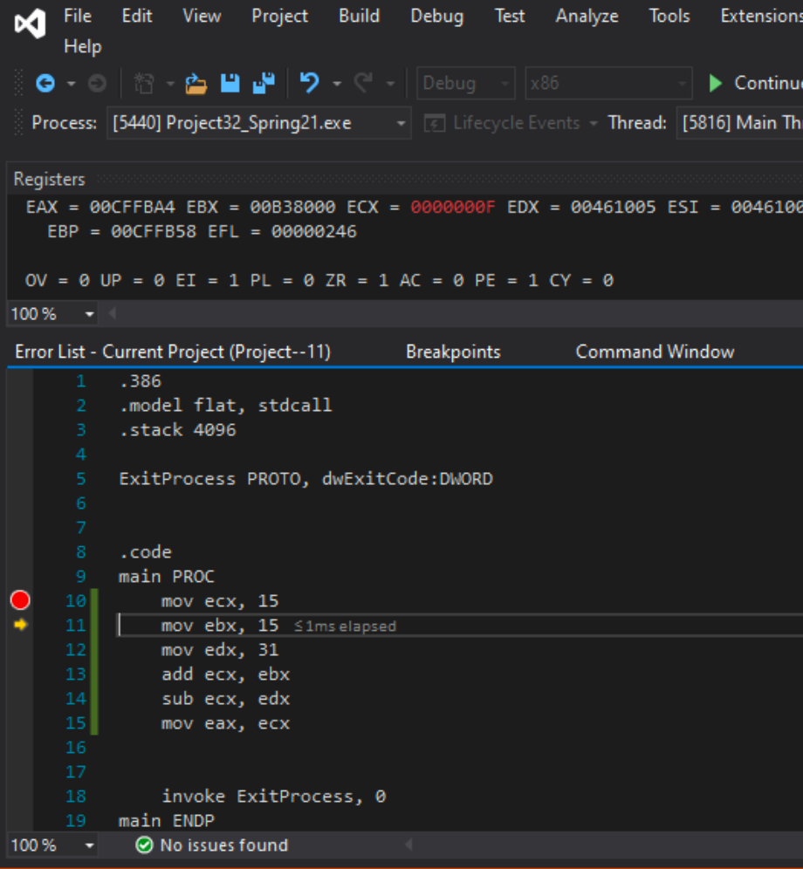
Debug the Project
To execute line 10, Select ‘Step over’ from debug menu
OR You can also use shortcut : Fn+F10
Now the yellow pointer moved to line 11. That means line 10 is executed.
Check the ECX register content.
You can see the hexadecimal representation of decimal 15.

Slide 37
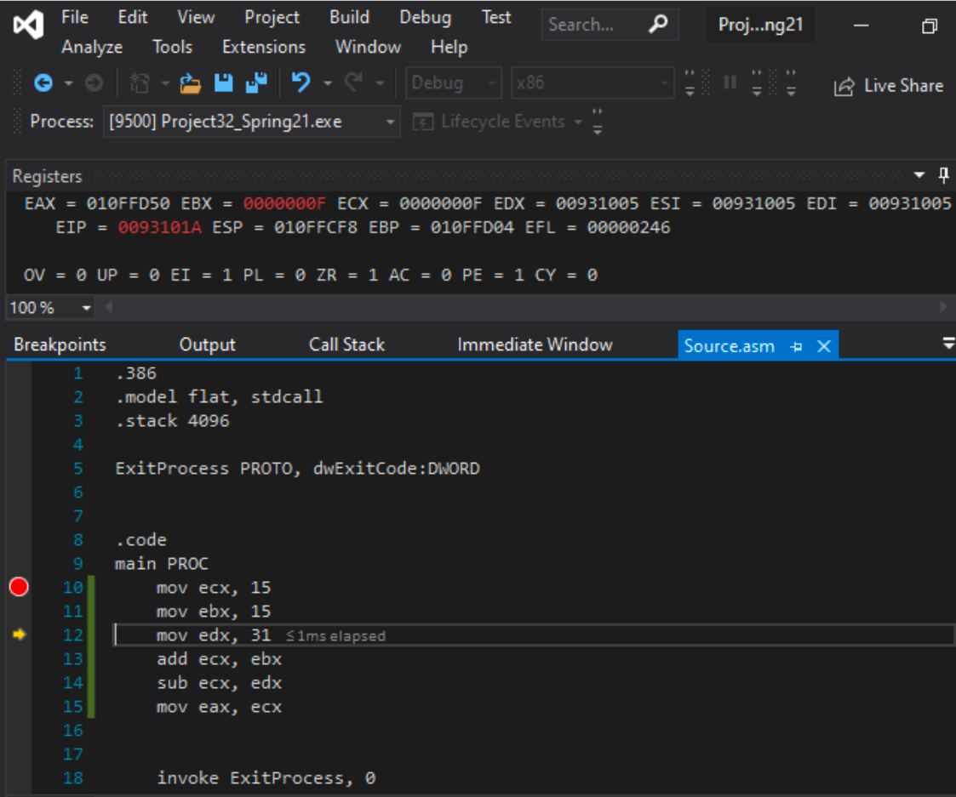
Debug the Project
To execute line 11, Select ‘Step over’ from debug menu
OR You can also use shortcut : Fn+F10
Now the yellow pointer moved to line 12. That means line 11 is executed.
Check the ECX register content.
You can see the hexadecimal representation of decimal 15.

Slide 38
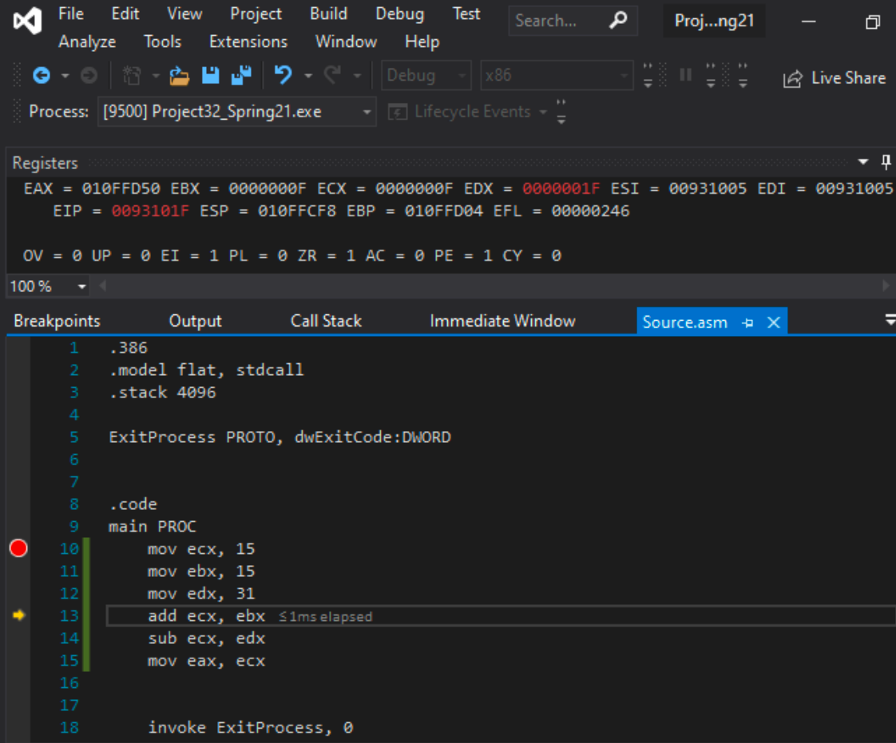
Debug the Project
To execute line 12, Select ‘Step over’ from debug menu
OR You can also use shortcut : Fn+F10
Now the yellow pointer moved to line 13. That means line 12 is executed.
Check the EDX register content.
You can see the hexadecimal representation of decimal 31.

Slide 39
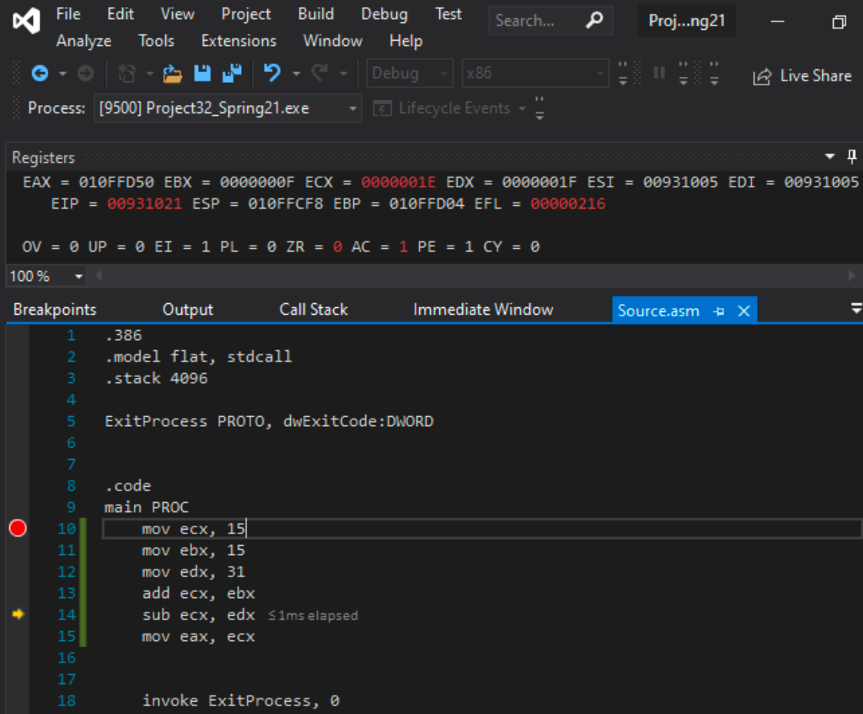
Debug the Project
To execute line 13, Select ‘Step over’ from debug menu
OR You can also use shortcut : Fn+F10
Now the yellow pointer moved to line 14. That means line 13 is executed.
Check the ECX register content.
Add instruction performs (15+15) and stores the result in ECX in hexadecimal, 1E.

Slide 40
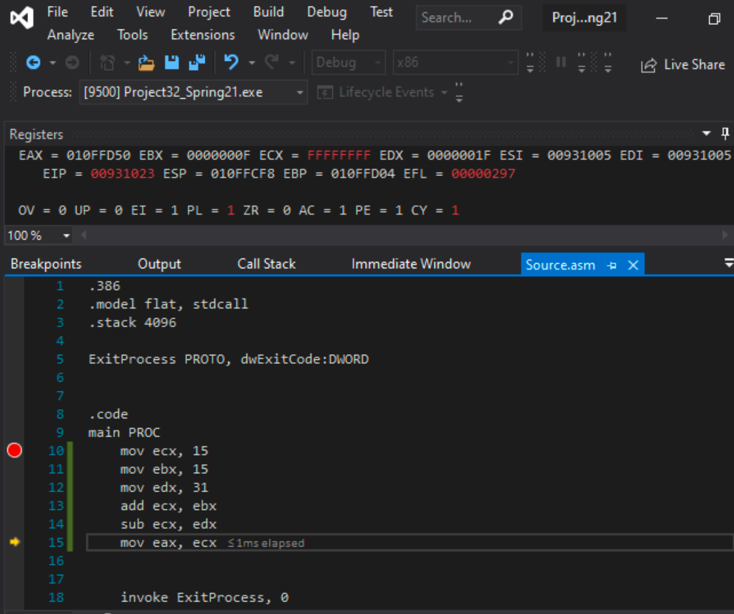
Debug the Project
To execute line 14, Select ‘Step over’ from debug menu
OR You can also use shortcut : Fn+F10
Now the yellow pointer moved to line 15. That means line 14 is executed.
Check the ECX register content and the flags.
Sub instruction subtracts edx from ecx.
That is (30-31) in decimal.
Result = -1
You can see the result in ECX = FFFFFFFF
That is 2’s complement of -1 in 32-bit.

Slide 41
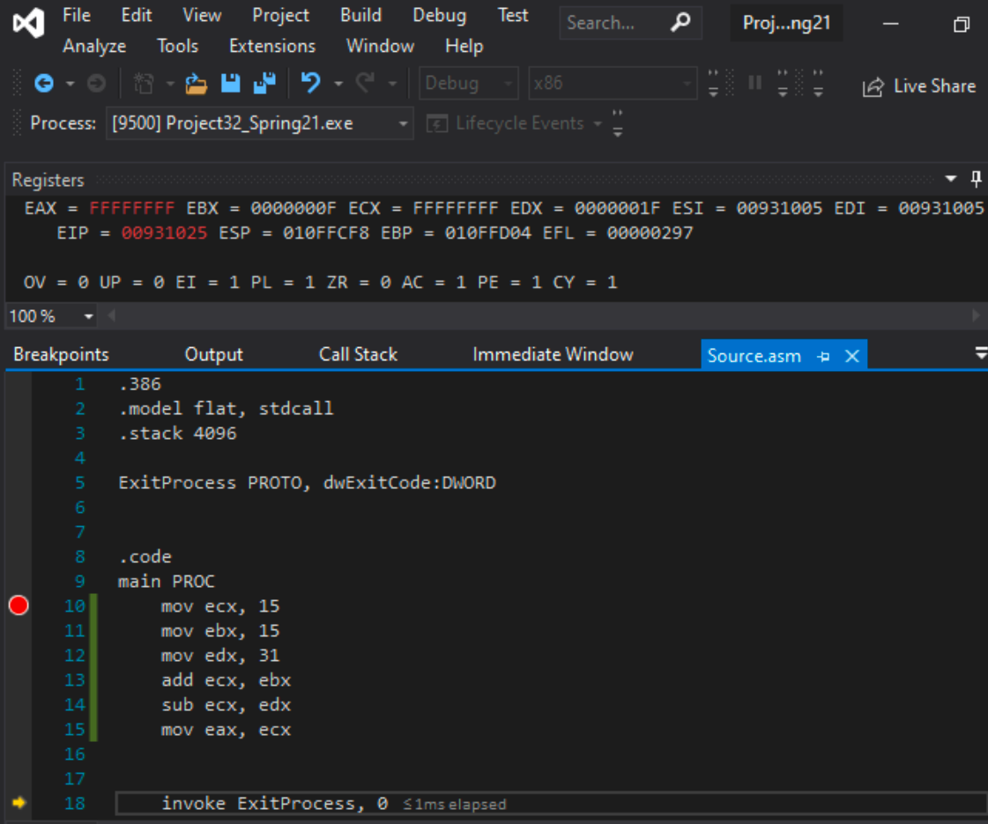
Debug the Project
To execute line 15, Select ‘Step over’ from debug menu
OR You can also use shortcut : Fn+F10
Now the yellow pointer moved to line 16. That means line 15 is executed.
Check the EAX register content.

Slide 42
Debug the Project
After you reach the ”INVOKE ExitProcess, 0”
Do not click Step over or Fn+F10
What is the status of the sign flag (PL) ?

Slide 43
Lab 4
Submission Instruction

Slide 44
Problem 1
Assume that you have 8-bit registers.
Write and run a program to evaluate the following expression:
AL = (AL – DL) + CL - BL
Store the following decimal values into the registers
Store 245 to AL register
Store 41 to BL register
Store 11 to CL register
Store 215 to DL register
Evaluate the above expression
Result should be at AL register at the end

Slide 45
Submission Instruction
There is an answer sheet attached to the lab (similar to lab-3b)
Debug through each line of your code.
Execute the instruction
Take a screenshot of the code and register window
Record the line number, instruction, Register values in the answer sheet.
Also add the screenshot
Then explain the register contents. (similar to lab-3b)

